Slide 1

SOOTH EASE An IOT-Driven Smart Cradle for Baby’s Comfort and Well-Being
Presented by:
M.S.L.SAI SRAVANTHI (22A95A0513)
V.KARTHIK BABU(22A95A0519)
B.MANI KANTA (21A91A05B2)
T.V.V.SATYA TEJA (21A91A05A1)
Guide Name:
Dr. K.Swaroopa, M.Tech., Ph.D. Associate Professor & HOD

Slide 2

OUTLINE
Abstract
1.Introduction
1.1 Problem Statement
1.2 Aim & Objectives of the project
1.3 Existing system
1.4 Proposed System and Advantages
2.Requirements Specification
3.Literature Survey Comparison Table
4.Architecture/Project Flow
5.Technology/Algorithm Used
6.Conclusion
7.References

Slide 3
ABSTRACT
This project proposes the design of a Smart Baby Cradle integrated with IoT technology to automate key functions aimed at improving infant care and reducing parental stress. The cradle will feature automated oscillation, motion detection, moisture sensing, and temperature monitoring, ensuring that the baby remains comfortable and well cared for even when parents are unavailable. Using a moisture sensor, the system can detect wet conditions and alert parents, while a motion sensor triggers oscillations to soothe the baby based on movement. Additionally, a temperature sensor ensures an optimal environment for the baby. The cradle will be powered by a microcontroller ESP32 and a motor to automate oscillation, with a buzzer providing notifications. This IoT-enabled system aims to improve the baby’s sleep comfortability, reduce the need for constant monitoring, and enhance convenience for parents, offering a responsive, automated solution for infant care.

Slide 4
Introduction
The "SoothEase" project is an IoT-driven smart cradle designed to improve infant care and reduce parental stress through automation. The cradle integrates features like automated oscillation, moisture and temperature monitoring, and motion-based soothing. These functionalities aim to address the limitations of traditional cradles by responding effectively to a baby's needs, such as detecting discomfort or environmental changes. Powered by an ESP32 microcontroller, the system incorporates sensors and actuators to create a responsive and efficient solution. This innovation enhances convenience for parents, especially during nighttime or multitasking scenarios, offering a smarter way to care for babies.

Slide 5
Aim & Objective
Aim
To develop a smart cradle system equipped with IoT technology to automate functionalities like oscillation, moisture detection, and temperature monitoring, ensuring the baby’s comfort and safety.
To provide parents with real-time alerts and a responsive monitoring solution to reduce stress and enhance convenience, especially during nighttime or multitasking scenarios.
Objective
Automated Cradle Oscillation: Implement a system to automate cradle oscillations at pre-configured intervals or based on baby movement to provide comfort.
Moisture Detection and Alerts: Integrate sensors to detect wet conditions in the cradle and notify parents promptly for timely action.
Motion-Triggered Soothing: Enable the cradle to detect baby movements and initiate soothing mechanisms, such as oscillations, during discomfort or restlessness.
Temperature Monitoring: Continuously monitor the cradle's environment using temperature sensors to ensure optimal conditions for the baby.

Slide 6
EXISTING SYSTEM
Automated Cradle Motion: Utilizes a servo motor to provide smooth and adjustable oscillations for soothing the baby.
Wetness Detection: Equipped with a moisture sensor to detect diaper wetness and notify parents via alerts.
Sound Sensing: Includes a sound sensor to detect baby cries and activate cradle motion or send alerts.
Emotion Recognition: Implements a camera with a machine learning model to classify baby emotions like happy, sad, or crying.

Slide 7
PROBLEM STATEMENT
Traditional baby cradles lack automated features to monitor and respond to a baby's needs, leading to challenges in providing timely care and comfort. Parents often face difficulties in addressing a baby’s movements or discomfort, such as wet conditions or prolonged inactivity, especially during night time.

Slide 8
PROPOSED SYSTEM
The IoT-enabled smart cradle integrates sensors to monitor parameters like motion, moisture, and temperature, ensuring the baby’s comfort and safety.
Automated oscillation is triggered by motion or sound detection, providing soothing oscillations without manual intervention.
Real-time alerts and data are sent to parents via a mobile application, allowing remote monitoring and timely action.
The system reduces parental workload and ensures a responsive, safe, and nurturing environment for the baby.
Advantages
Automated oscillation mechanism for soothing the baby.
Wetness detection using moisture sensors.
Temperature monitoring to maintain an optimal environment.
Motion-based alerts for baby activity detection.
Real-time notifications to parents via a connected app.

Slide 9
REQUIREMENTS SPECIFICATION
SOFTWARE REQUIREMENTS :
IoT Platforms: Adafruit.io or Blynk for cloud data storage and alerts.
Integrated Development Environment (IDE): Arduino IDE for ESP32 programming.
HARDWARE REQUIREMENTS :
Soil Hygrometer Moisture Sensor (to detect wet conditions).
MPU6050 Motion Sensor (for detecting baby movements).
DHT22 Temperature Sensor (for environmental monitoring).
Tower Pro MG995 Servo Moto
Microcontroller – ESP32
Buzzer for Sounds
Relay Module
Bread board Jumper Wires
Breadboard

Slide 10
LITERATURE SURVEY COMPARISION
S.No | Reference Paper Title | Year of Paper Published | Purpose/ | Drawbacks/ Advantages
1 | Iot Based Smart Cradle for Infant Health Monitoring Using NodeMCU | 2024 | To create an IoT-based smart cradle that automates baby care by monitoring motion, moisture, and sound, ensuring infant safety and comfort while reducing parental stress. | Automates cradle oscillation and care. Provides real-time alerts for enhanced safety. Enables remote monitoring for working parents.
2 | IOT and Embedded Based Smart Baby Cradle | 2023 | To develop an IoT and embedded system-based smart cradle that automates baby care through features like oscillation, wetness detection, and sound sensing to ensure infant comfort and reduce parental stress. | Provides automated swinging and real-time alerts for baby care. Enhances safety and comfort for infants. Supports remote monitoring and control via IoT integration.
3 | IoT based Smart Cradle for Neonatal Monitoring | 2022 | To design a smart cradle using IoT technology for automated baby care, incorporating sensors to monitor temperature, moisture, and sound, and providing real-time alerts to ensure infant comfort and safety. | Automates monitoring and care, reducing parental stress. Provides real-time alerts for immediate action. Supports remote access via mobile applications.

Slide 11
LITERATURE SURVEY contin…..
S.No | Reference Paper Title | Year of Paper Published | Purpose/ | Drawbacks/ Advantages
4 | IoT based Smart Cradle for Baby Monitoring System | 2021 | To provide real-time monitoring and comfort for infants while reducing parental stress. It automates cradle oscillation, monitors environmental conditions like temperature and humidity, and detects baby movement and cries, ensuring the baby's well-being. | Monitors baby’s vitals and automates cradle oscillation based on movement or crying. Adjusts temperature and alerts parents for discomfort or diaper wetness. Provides real-time video and data updates via a mobile app for parental convenience.
5 | IoT based Smart Baby Cradle System using Raspberry Pi B+ | 2020 | To create an IoT-based Smart Baby Cradle system using Raspberry Pi that automates baby monitoring and comfort through features like emotion detection, automatic cradle swinging, wetness detection, and mobile app control. | Live video and status updates ensure constant supervision. Wet sensors prevent health issues related to wet mattresses. Adjustable swinging speeds and soothing music for the baby
6 | SOOTH EASE : An IOT-Driven Smart Cradle for Baby’s Comfort and Well-Being | 2025 | To create an IoT-enabled smart cradle that automates baby care with features like automated oscillation, wetness detection, temperature monitoring, and real-time notifications, ensuring infant comfort and parental convenience. | Reduces parental workload with automated functions like automated oscillation, motion detection, moisture sensing, and temperature monitoring. Enhances baby safety and comfort through continuous monitoring. Provides real-time alerts for timely parental response.

Slide 12
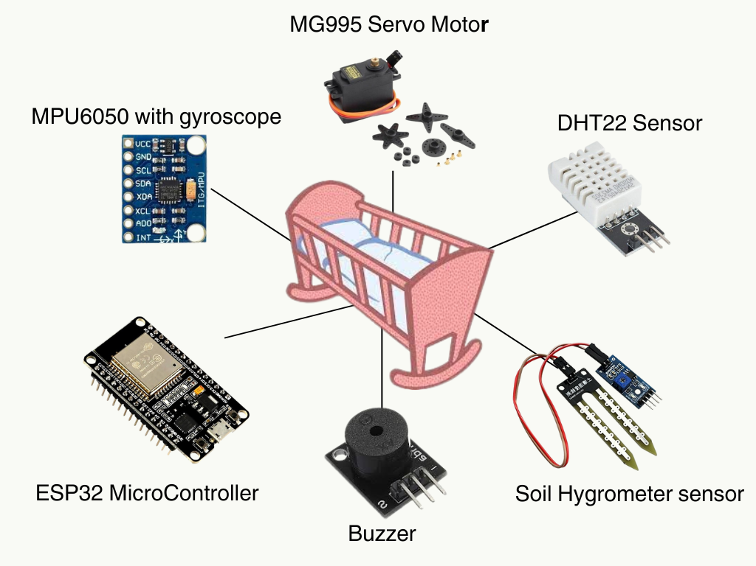
ARCHITECTURE

Slide 13
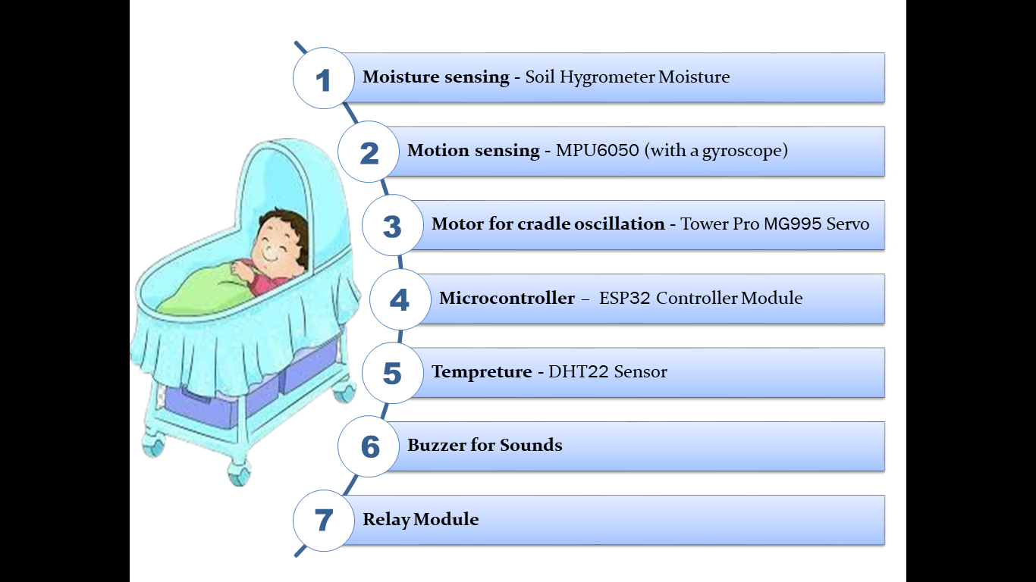
TECHNOLOGY/ALGORITHM
The project utilizes an IoT-enabled system driven by the ESP32 microcontroller to manage real-time monitoring and automation. Key algorithms include signal processing for motion detection using the MPU6050 sensor, wetness detection via moisture sensors, and temperature monitoring using the DHT11 sensor. Data is transmitted to a cloud platform for remote access and notifications, ensuring efficient alerts. Additionally, control algorithms regulate servo motor oscillation and adjust rocking intensity based on detected baby movements or cries.

Slide 14
CONCLUSION
The IoT-based smart cradle ensures infant safety and comfort through automated oscillation, wetness detection, and temperature monitoring. It reduces parental stress by providing real-time notifications and remote monitoring, offering a modern, efficient solution for baby care.

Slide 15
REFERENCES
Iot Based Smart Cradle for Infant Health Monitoring Using NodeMCU :- https://www.ijfmr.com/papers/2024/2/17031.pdf
IOT and Embedded Based Smart Baby Cradle :- https://www.researchgate.net/publication/378387476_IOT_and_Embedded_Based_Smart_Baby_Cradle
IoT based Smart Cradle for Neonatal Monitoring :- https://ieeexplore.ieee.org/document/10009138
IoT based Smart Cradle for Baby Monitoring System :- https://ieeexplore.ieee.org/document/9358684
IoT based Smart Baby Cradle System using Raspberry Pi B+ :- https://ieeexplore.ieee.org/document/9299602

Slide 16
THANK YOU

